Slide 1
Flash For Computer Games
By Lewis Hawkins

Slide 2

Flash for Game Development
FlashDevelop is an integrated development environment (IDE) for the development of Flash websites, web applications and video games.
The applications made with FlashDevelop are run on Flash Player or Adobe AIR, on Microsoft Windows, Mac OS X, Android, or iOS.

Slide 3
ActionScript
Advantages
Disadvantages
ActionScript 3.0 offers a 10-fold increase in performance over pervious versions of the language.
ActionScript 3.0 includes hundreds of new APIs to work with.
It’s object orientated.
Flash Player is installed on 97% of all internet enabled computers.
Easy to learn.
Learning curve for more advanced ActionScript is steep.
Screen renders for the blind can’t read all aspects of Flash files.
Not enough power to run complex programmes.

Slide 4
ActionScript vs Animation
ActionScript
Animation
ActionScript allows you to loop animations, meaning you don’t have to create longer walk cycles.
Since its code, its easy to just change values to alter the overall look.
You can randomly generate movement.
Animation is one movement which cannot be changed. It also cannot be repeated without having to create the whole animation again.
There’s no code involved so you don’t have to learn ActionScript.

Slide 5

Limitations of Flash
Flash is going to be shut-down in 2020.
ActionScript is cannot compete with other languages.
Games have to be run using Flash Player.
Very limited 3D animation capabilities.
The layout can be confusing.
Long load-up times.

Slide 6

Flash Lite
A lightweight version of Flash Player.
Used for lower-end platforms, like mobile and Wii.
It allows multimedia content to be developed using Adobe Flash's tools.

Slide 7
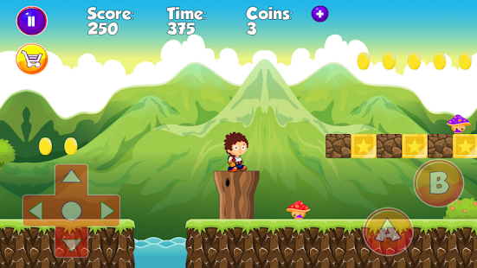
Making Artificial Worlds
Making artificial worlds is all about making them believable, and fit for purpose. The world needs to feel alive which is usually created through making trees move, adding birds or other creatures, and layers of perspective.

Slide 8
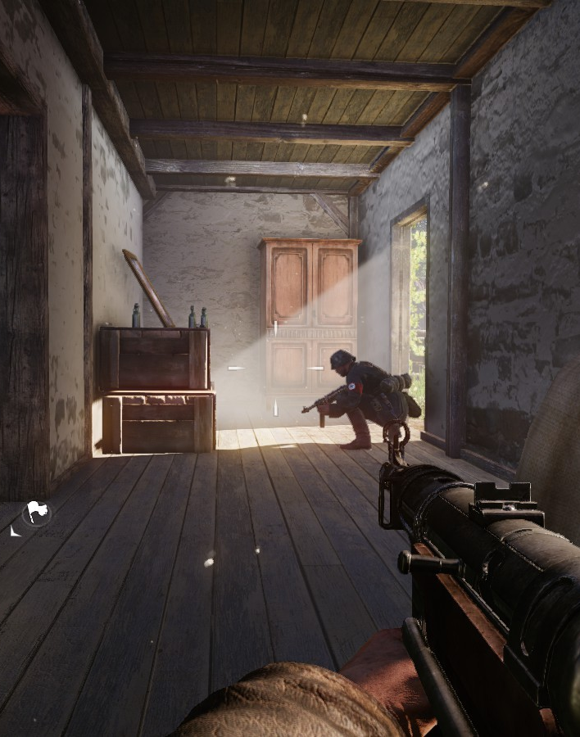
Interactivity
The player needs to be able to interact with many objects within the game. Whether it’s just enemies and doors, or as much as grass moving under the players feet, it all goes towards making the game believable.

Slide 9
Objects
An object in a game is also known as an “entity”, and a “Game Object”.
There’re two types of objects; physical, and non-physical.
Physical objects are objects that either react to an input/event, or are visible to the player.
Non-physical objects are invisible objects that work independently to the player.
Both have an important role whether it’s the Player (Physical) or a Save Manager (Non-physical).

Slide 10
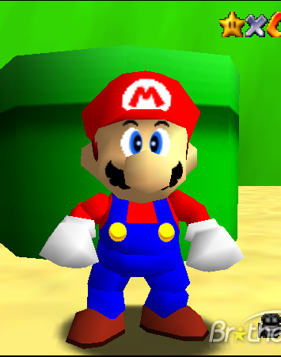
Story
A games story is important to keeping players entertained.
It doesn’t have to be long and in depth like God of War, it can be short and only serve to add meaning to the gameplay like Mario.
Mario’s story is simply save the princess and defeat Bowser

Slide 11
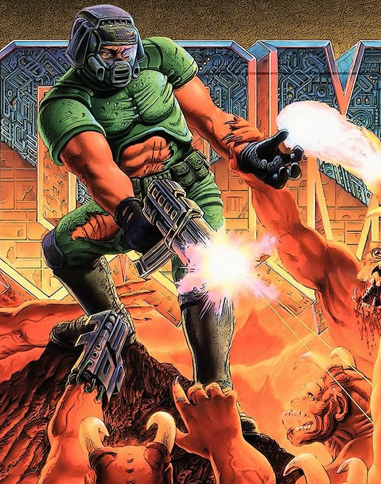
Doom 1993
Doom is one of the many popular games made with Flash, and is one of to few FPS genre defining games in gaming.
Doom’s story is simply to clear out the invading demons.

Slide 12
Sound
Ambient sound is a good way of making a world believable, whether it’s birds or wind it provides a realistic result with little effort.
Gunshots are a more direct result of a players input. It acts as a confirmation that the player has called for the game to respond.

Slide 13
Game Plan
Main Character
Role of Objects
The main character is who the player plays as.
They’re usually the most flushed out.
They’re the centre of the story.
They’re used to make the game believable.
They’re used to provide the player something to interact with.
They can be used to give the player an idea of how to compete tasks.

Slide 14
How Games Are Made in Flash
This chart displays the development cycle of a game made in flash.
Time | 10% | 20% | 30% | 40% | 50% | 60% | 70% | 80% | 90% | 100%
Original Concept
Asset Creation
Prototype
Alpha
Beta
Final Testing
Release

